Slide 1
IBM University Engagement Project Submission
“Exploring the Power of Agentic AI with IBM Granite and LangFlow”

Slide 2

Project Tile – Course Content Simplification Agent
Domain of Project : Education
Student Name | Recent Passport Photo | Email ID | Mobile number [WhatsApp]
Maddula.Pranathi |  | pranthimaddula05@gmail.com | 9392148573

Slide 3
Problem Statement -
Problem Statement :Course Content Simplification Agent
The Challenge
Many students, especially first-generation learners and those from non-English medium backgrounds, struggle to understand complex academic course material. Textbooks, research papers, and lecture notes often use technical jargon or dense explanations, making it difficult for students to grasp core concepts independently. This comprehension gap leads to lower academic performance, reduced confidence, and a growing divide in learning outcomes — particularly in under-resourced or rural educational institutions. There is a pressing need for a solution that can automatically simplify educational content into clear, digestible formats suitable for a diverse student population.
The Objective
Simplify Complex Academic Material Automatically convert textbooks, lecture notes, and research papers into clear, digestible explanations that are easy to understand.
Bridge Language & Comprehension Gaps Provide simplified content tailored for first‑generation learners and students from non‑English‑medium backgrounds.
Enhance Academic Confidence & Performance Support students in grasping core concepts independently, thereby improving learning outcomes and reducing dropout risks.
Enhance Academic Confidence & Performance Support students in grasping core concepts independently, thereby improving learning outcomes and reducing dropout risks.
Enable Adaptive Learning Levels Offer explanations at beginner, intermediate, and advanced levels to match diverse student proficiency.
Support Multi‑Language Accessibility Integrate translation features so simplified content can be delivered in regional languages.
Provide Quick Summarization Tools Generate concise summaries for revision and exam preparation, reducing study time pressure.

Slide 4
Technology Used
Tech Stack (Mandatory)
Use any one of the following approaches:
LangFlow + IBM watsonx.ai + Granite Models
IBM Cloud Agentic Lab with IBM Granite Models
Replicate with LangChain + RAG + IBM Granite Models
Used IBM Orchhestrate to create an agent
I used IBM Orchestrate

Slide 5
Proposed Solution -
Proposed Solution: AI‑Powered Course Content Simplification Agent
AI‑Driven Text Simplification Develop a system using Natural Language Processing (NLP) and Large Language Models (LLMs) to automatically simplify textbooks, lecture notes, and research papers into clear, jargon‑free explanations.
Multi‑Level Explanations Provide content at three levels of complexity (beginner, intermediate, advanced) so students can choose explanations that match their current understanding.
Multi‑Language Support Integrate translation and localization features to deliver simplified content in regional languages, ensuring accessibility for non‑English medium learners.
Interactive Learning Tools Offer summaries, flashcards, and quizzes generated from simplified content to reinforce understanding and aid exam preparation.
Adaptive Personalization Use student profiles and learning analytics to tailor simplification depth, examples, and analogies based on individual needs.
Cloud‑Based Deployment Host the solution on IBM Cloud Lite with Granite models for scalability, cost‑effectiveness, and easy integration into institutional platforms.
Offline & Low‑Bandwidth Access Provide downloadable simplified notes and summaries for students in rural or under‑resourced areas with limited internet connectivity.
Educator Integration Allow teachers to upload course material and receive simplified versions, enabling them to support diverse classrooms more effectively.

Slide 6
Langflow component Used -
1) Chat Input – Interface where users enter their queries, preferences, or meal details (text/voice/image).
2) IBM watsonx AI Agent - Processes user input using Granite models to generate personalized nutrition insights and recommendations.
3) Name of IBM Granite model - Granite-4.0-8B-Instruct → Fast, efficient for real-time diet recommendations
4) Chat output -Displays AI-generated responses such as Chat outputs are the student‑friendly results like simplified explanations, summaries, quizzes, translations, and confidence‑building suggestions.
5) File component - Stores and retrieves user data ,datasets for analysis and tracking.
6) IBM Orchestrate.

Slide 7
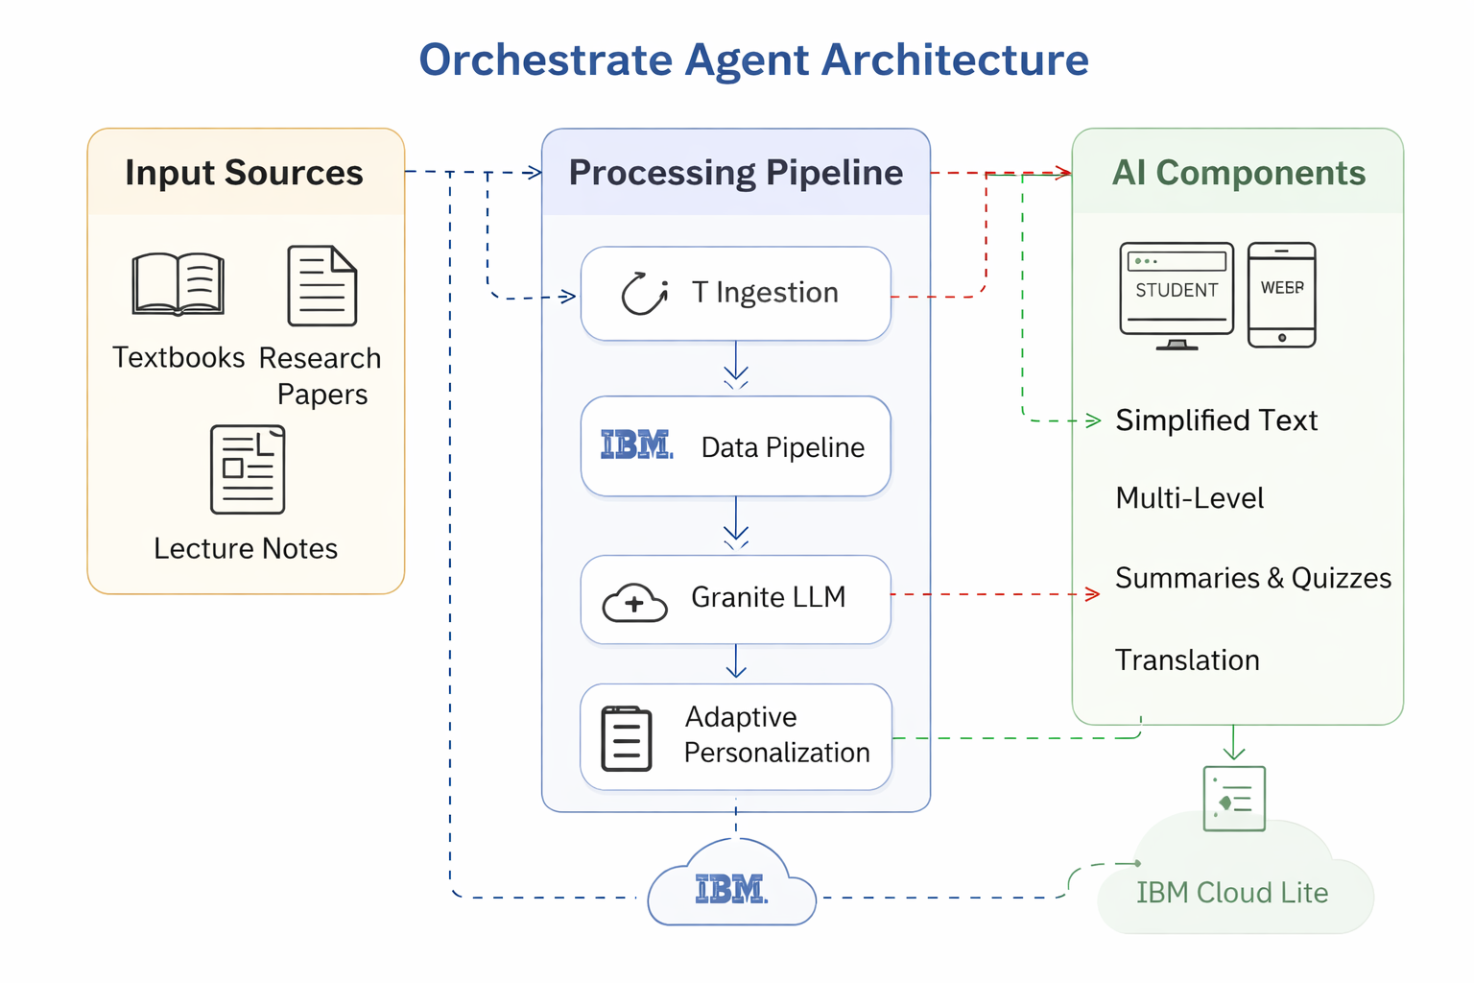
Architecture blueprint

Slide 8
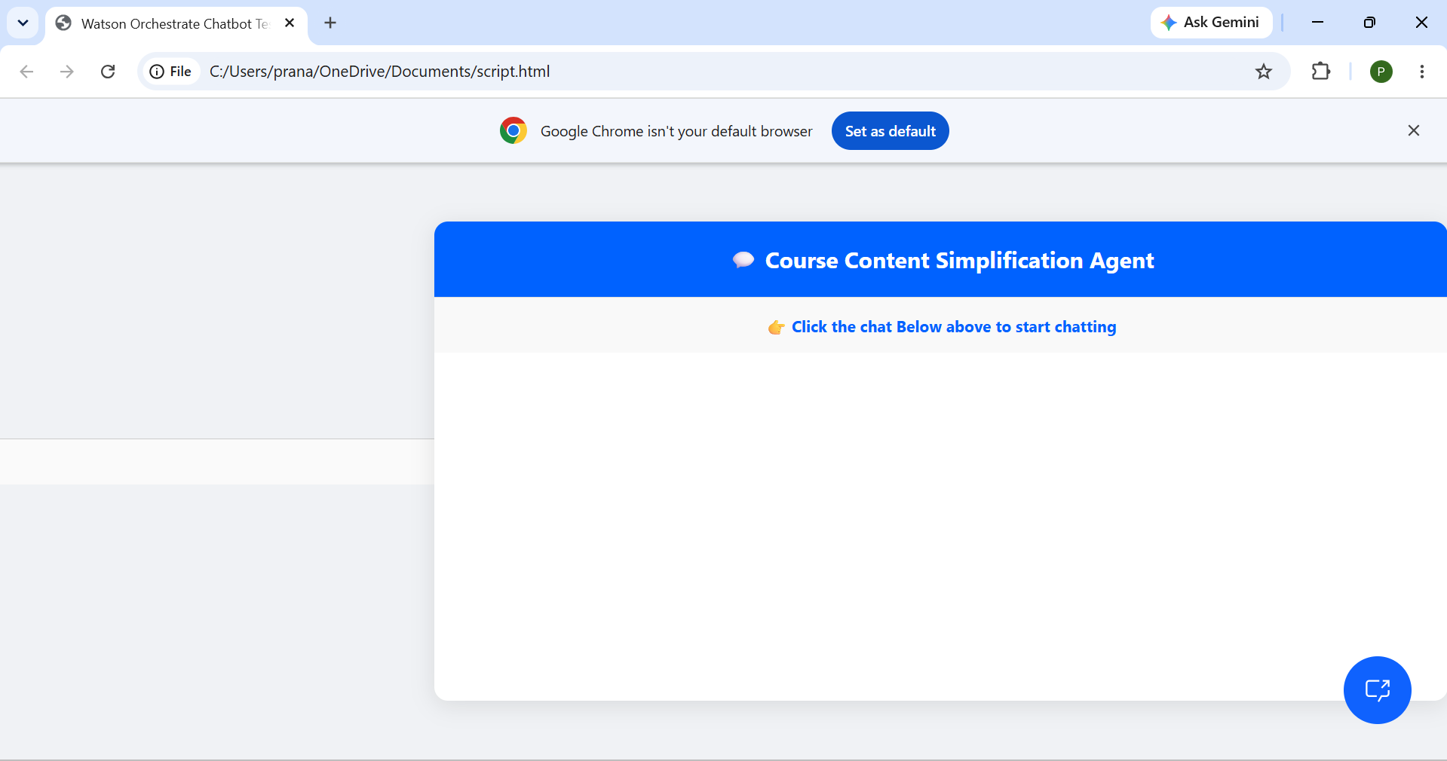
Output Screens:

Slide 9
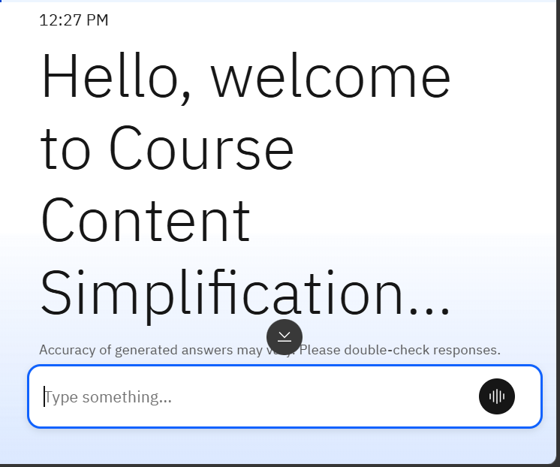
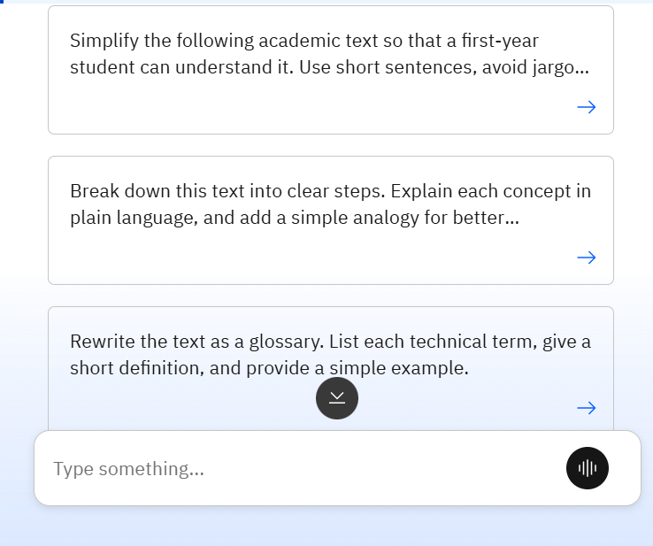
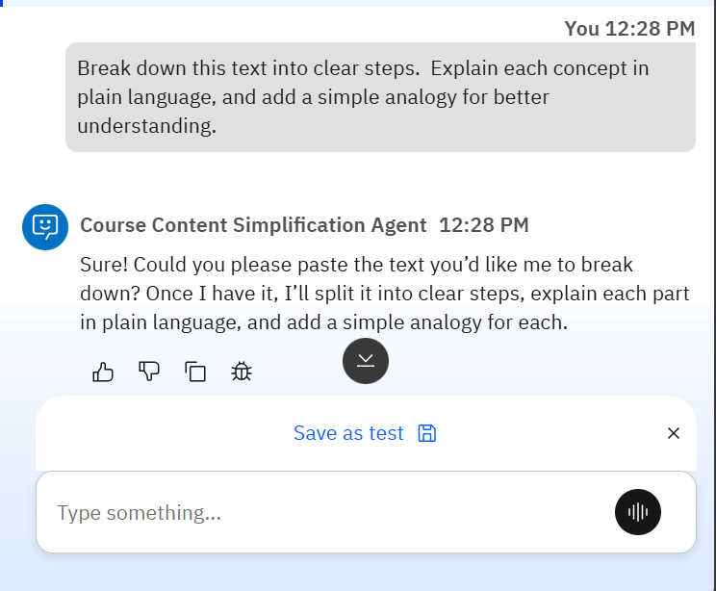

Slide 10
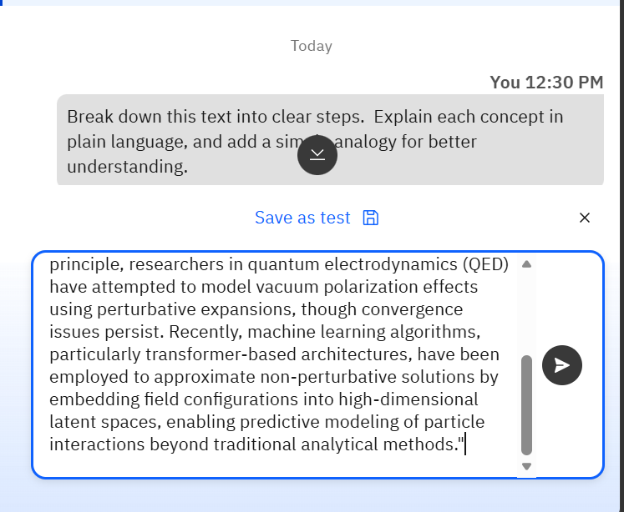
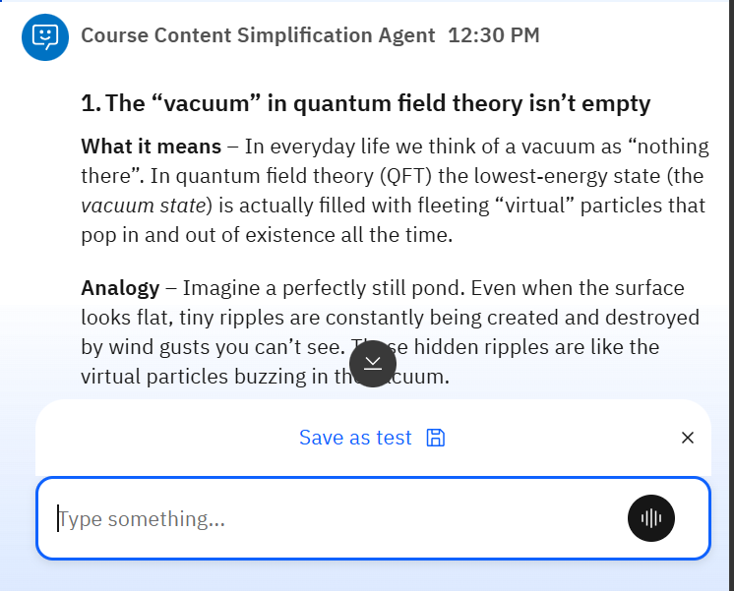

Slide 11

Role of Agentic AI in the solution
Role of Agentic AI in Nutrition Agent
Agentic AI plays a central role by acting as the intelligent orchestrator that connects all system components. It performs autonomous task execution, meaning it can simplify, summarize, and translate content without manual input. Through goal‑oriented workflows, it decides which models or tools to use for each student query. Its dynamic decision‑making allows it to select the right complexity level for explanations, while context awareness ensures accurate results by retrieving relevant academic data. It also supports continuous learning and personalization, adapting to each learner’s needs, and works with Granite Guardrails to maintain safe, unbiased educational outputs — making it the core decision‑making engine of your Orchestrate Agent system.

Slide 12
Technology Used
Langflow platform -For designing and orchestrating multi-agent workflows visually
IBM Grainte model - for eg – ibm-granite-3-2-8b – For natural language understanding, reasoning, and personalization
IBM Cloud – It provides the infrastructure to build, deploy, and scale the Nutrition Agent efficiently. IBM Cloud enables a reliable, secure, and scalable environment for deploying the Nutrition Agent.
IBM Watsonx.ai - For model deployment, embeddings, and AI governance
Vector Database (FAISS/Chroma) – For RAG-based nutritional data retrieval
IBM Orchestrate- for building and traing the model

Slide 13
Novelty and Uniqueness
The proposed Course Content Simplification Agent stands out by combining Agentic AI, RAG, and personalization into a single intelligent system.
Multi-Agent Intelligence – Instead of a single chatbot, multiple specialized agents collaborate (simplification, summarization, translation, personalization) to deliver accurate and context‑aware learning support..
RAG-Based Accuracy – Integrates real‑time retrieval of academic references, glossaries, and definitions with AI generation, reducing misinformation and ensuring trustworthy explanations.
Hyper-Personalization – Tailors simplified content based on learner profiles, proficiency levels, and language preferences, making education more inclusive.
Real-Time Feedback Loop – Continuously adapts explanations and quizzes based on student interactions, comprehension levels, and performance analytics.
Multi-Modal Input – Supports text, voice, and document uploads (PDFs, notes, research papers) for flexible content ingestion.
Preventive Healthcare Focus – Goes beyond simplification to provide accessibility for first‑generation learners, rural students, and non‑English medium backgrounds.
Scalable & Enterprise-Ready Built on IBM watsonx.ai with Granite models, ensuring reliability, governance, and easy deployment across institutions.
This makes your solution a smart, adaptive, and proactive digital learning assistant — not just a static content simplifier.

Slide 14
Git Hub Link
· Please create public github repository (Enable Add README button while creating repository) with format –
Please test and Paste the working Github URL –MaddulaPranathi/IBM-Project
Make sure you have Uploaded following three files into your github repository 1) app.json file , 2) yourproblemstatement.pdf file 3) your projectpresntation.pptx file 4)any other files
·
·
·

Slide 15
Future Scope
1.AI-Powered Voice Assistant & Multilingual Support –
Enhancing the system with a voice-enabled assistant and support for multiple languages will improve accessibility. Users can interact naturally in their preferred language, making the solution more inclusive and suitable for diverse populations, especially in regions with varied linguistic backgrounds.
2.Expanded Language Coverage – Support more regional and global languages, ensuring inclusivity for diverse student populations.
·
·
·

Slide 16


